Slide 1

FASTAI Live video logo obfuscation
Cat Tensors
Scott Zanevra, Isaac Powell, Deyan Zafirov (Deki), Naziah Siddique, Moji Ghadimi

Slide 2
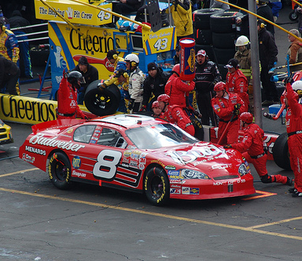
Project Objective & Problem Statement
Project aims to DETECT and OBFUSCATE a brand logo from clothing in a live video feed
Many movies, TV shows, music videos, and other visual media tend to blur out or remove logos of certain companies
This is widely known as product displacement
For example: Dale Earnhardt Jr’s #8 Chevrolet Monte Carlo was used in the animated film Cars with the beer advertising removed
Keep in mind: when a product or service of a brand is included in video media, this is a form of advertising
Producers would expect payment from the brand for this advertising
But if the brand refuses, then the producers can blur or remove the logo of the brand

Slide 3
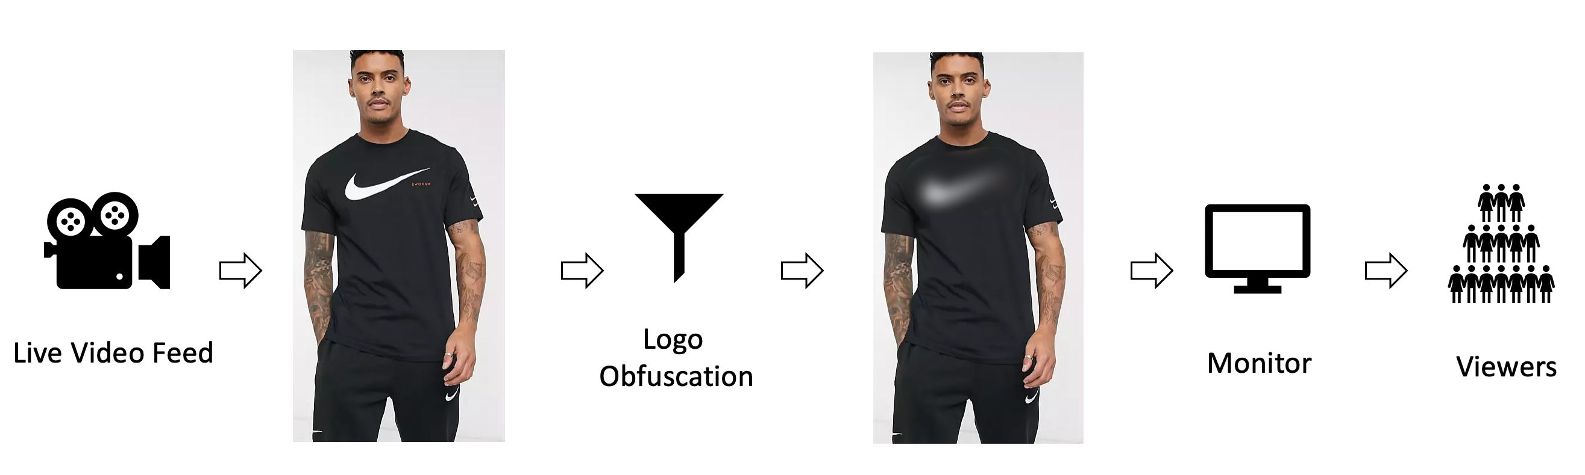
Basically, this is the workflow
The basic idea is:
Train the model to recognise a common logo a person is wearing
Detect the logo and obfuscate it
Apply this to live video
Our logo/brand of choice is the Nike ‘swoosh’ logo
It is ubiquitous enough that it is easily recognisable and easier to find a dataset compared to other logos (for example: AWS)

Slide 4
Approach
The main idea is to:
Train a model to detect the Nike ‘swoosh’ logo on items of clothing
Determine whether a person is wearing the clothing
If they are, then the logo is blurred
If the logo is not being on a person, then it won’t be blurred
Apply this idea to a live video (webcam) stream

Slide 5
Process Involved
Extrapolating from the previous slide, our process on getting from training a model to detect the Nike logo to blurring it via a live video stream took the following form:
Firstly used the Bing search API to download the Nike logo on jumpers, shoes, t-shirts and any other clothing
Annotated the Nike ‘swoosh’, Nike word, and people using the open source LabelImg tool (https://pypi.org/project/labelImg/)
Investigate various Object Detection Framework’s to find the best one
Selected the IceVision framework (https://github.com/airctic/icevision)
We then trained a model on the annotated image set, then validated on static images
The webcam client was implemented to detect humans and the Nike ‘swoosh’ logo on them
To detect humans (or objects) we trained multiple object-detection models using different model architecture: (1) RetinaNet, EfficientDet, and YOLOv5 (Ultralytics)
From these 3 we could adjust certain parameters (such as the learning rate or number of epochs) to determine which performed the best

Slide 6
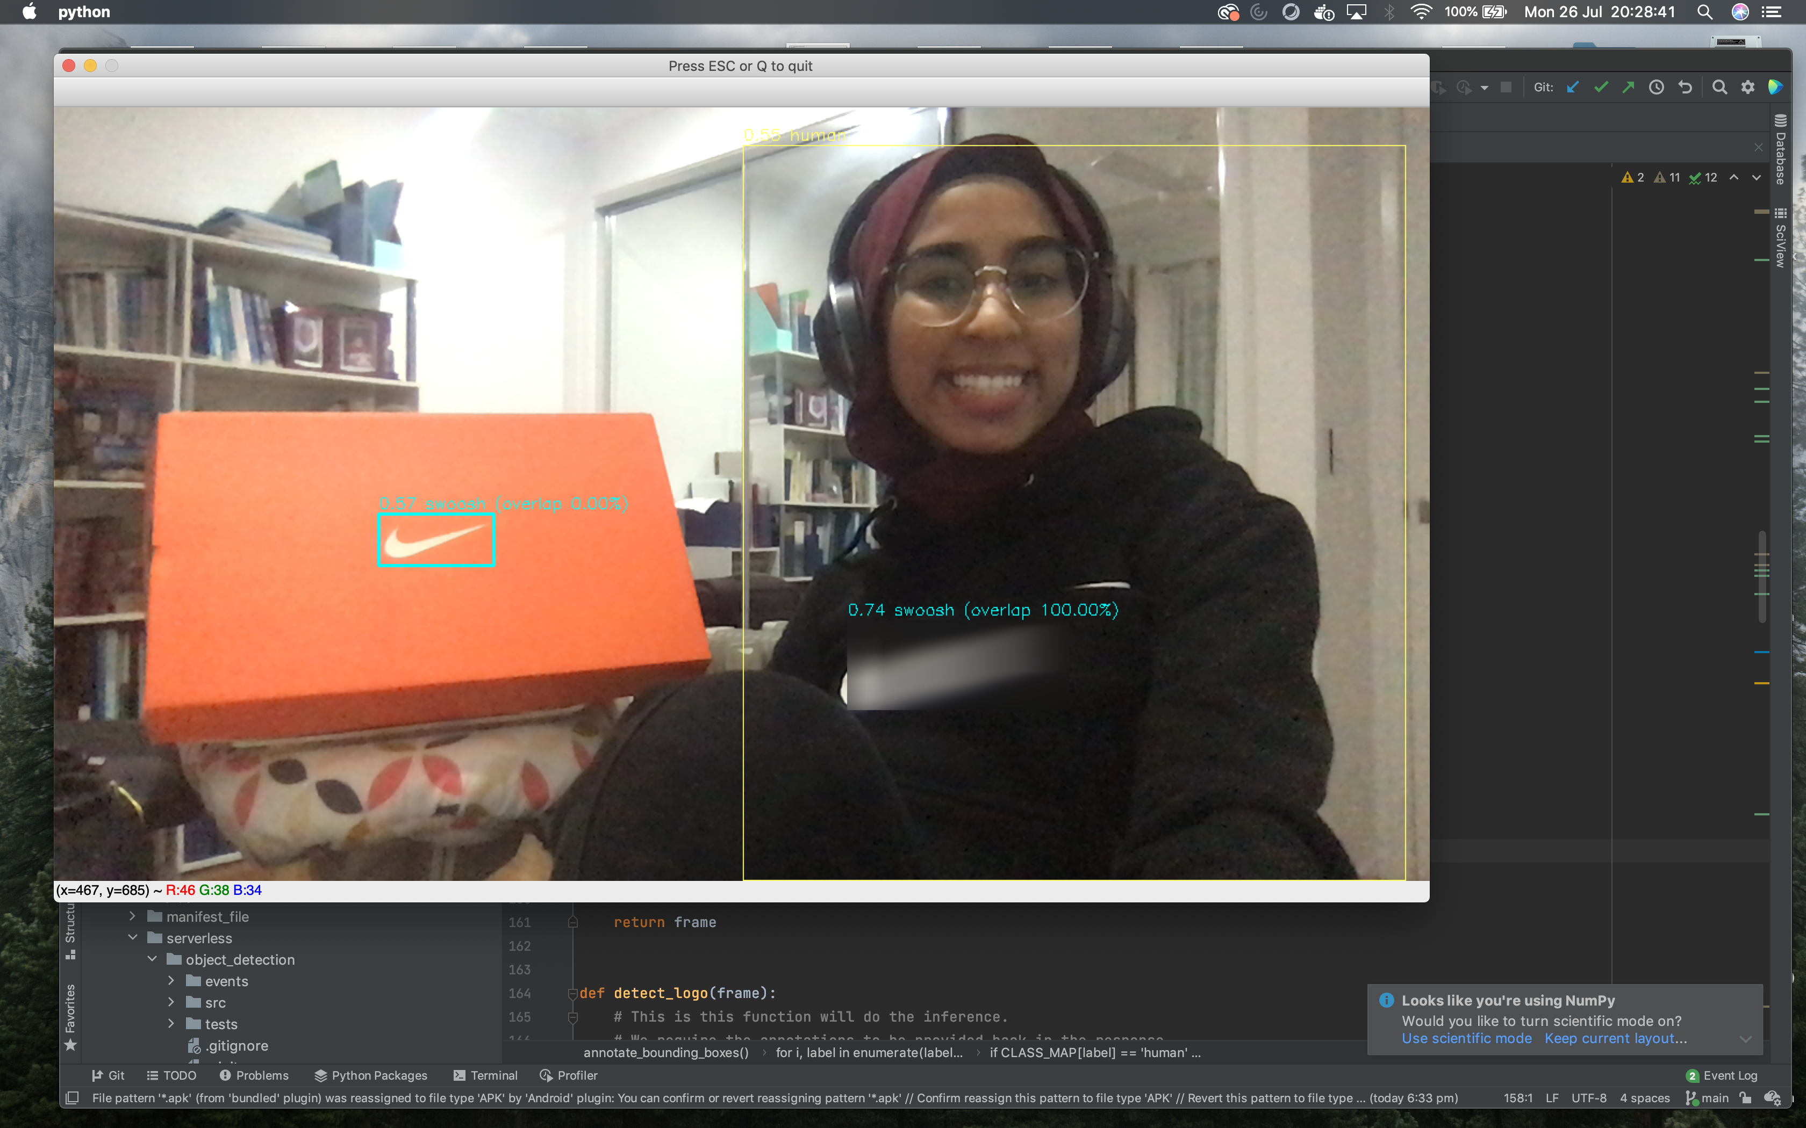
Examples from our test run
Model 1 accurately detected the Nike swoosh logo on Naziah’s jumper, then blurring it, whilst detecting it on the orange box, but not obfuscating it

Slide 7
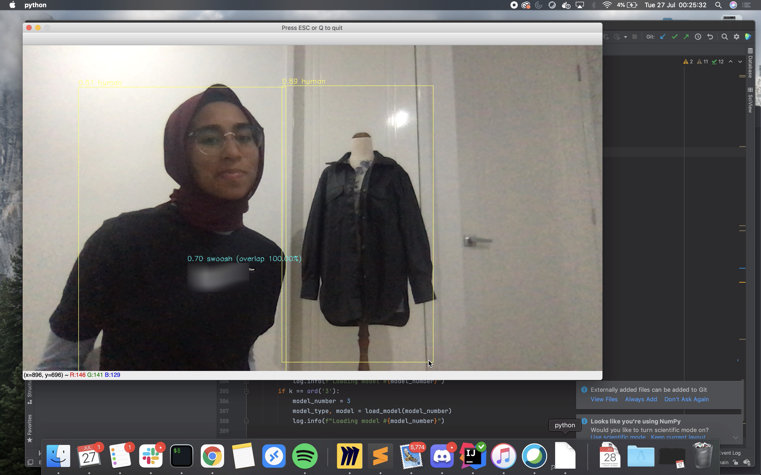
Examples continued
Although using Model 1 was not entirely accurate in detecting only humans, it still provides a good proof of concept

Slide 8
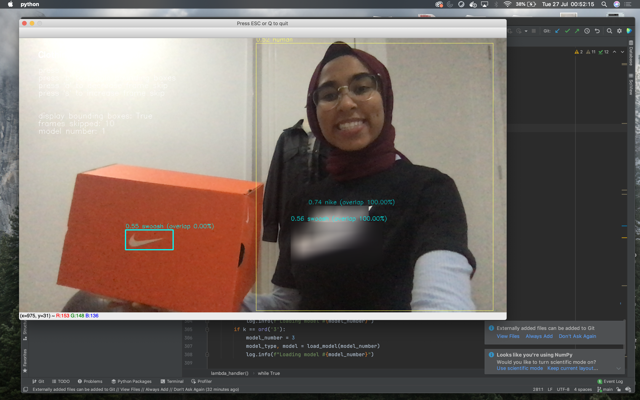
Examples continued
In this example, using Model 1, our model is able to detect the Nike text and ‘swoosh’ logo

Slide 9
Dataset Retrieval (will move this)
The original idea was to use the AWS logo, but finding the right dataset with enough images of people wearing the logo proved to be very difficult
The team decided to switch to the Nike logo
Put these points from the presentation in the readme file on github
Labelling the Nike people in the dataset improved accuracy
Older dataset had people in positions where they weren’t facing the camera/front
New imageset/dataset, labelled the people wearing the Nike clothing; lead to improved accuracy
Have a slide here to describe the zip file they use, open it up, read readme first, how to run it etc
Upload this to google slides
Being aware of the limitations (dataset bias) have a slide on limitations (future improvements)

Slide 10
Limitations/Future Improvements
Include the example here with Naziah and the mannequin, where it ascribes a higher value to the mannequin in a jacket. Could indicate bias in the data because she wears a headscarf, whilst the dataset doesn’t account for that

